Slide 1


Team 60: RADIAN
Bi-Weekly Update 1 Matthew Blackwell, Mitchell Hoffman, Wyatt Johnson Sponsor: Dr. Arya Menon TA: Manoj Kumar Balamurugan
Notes:
Michelle

Slide 2

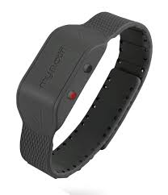
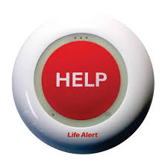
Problem Statement
Falls are the leading cause of injury in elderly
Fast detection saves lives through quick response
Current Solutions - Limitations:
Wearables → must be worn and charged
Push-buttons → user must be conscious/able to press
Camera → effective but invade privacy

Slide 3
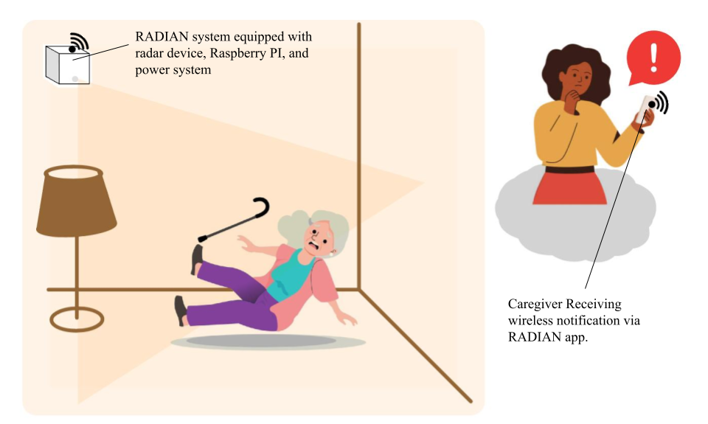
RADIAN System Summary
Proposed Solution:
Automatic Fall Detection
Works in real time
No user action needed
Privacy-Preserving
No camera
Protects independence
Reliable Response
Immediate accurate alerts to caregivers

Slide 4
System Overview
External Casing and Radome
Matthew Blackwell
Wyatt Johnson
PCB
Mitchell Hoffman
TI AWR6843
Phone App
Battery
External Alarm
Watchdog Timer
Serial (UART or USB)
Raspberry Pi 3
AI Algorithm / Signal Processing

Slide 5
Major Changes for RADIAN
Data Subsystem | Physical Subsystem | Wireless Subsystem
Changing from a decision tree model to a Convolutional Neural Network (CNN), causing a redesign of Data Subsystem. | Redesigned the Power PCB | No major changes since 403
Notes:
Eric

Slide 6
RADIAN Timeline
Planning
Switching ML models has caused the Data Subsystem to be shifted back into the design phase
Ongoing PCB testing
Improving code for radar to get more accurate data for integration
Data
Designing
Wireless
Subsystem Testing
Physical
Integration
System Testing
System Demo
Notes:
Eric

Slide 7
Data Subsystem
Changes since 403 ~35 hrs of effort | Ongoing progress and plans until the next presentation
The previous ML model was not sufficient for 404, in both technical merit and reliability when it comes time to integrate Researched new ML models for RADIAN, landed on a CNN for reliability and ability to learn different features Documented how data frames will work | Code a baseline model that can be improved as we start to integrate Integrate with Wireless to communicate through the Gotify server Start baseline trials and data cleaning to train ML model Document process for recording trials

Slide 8
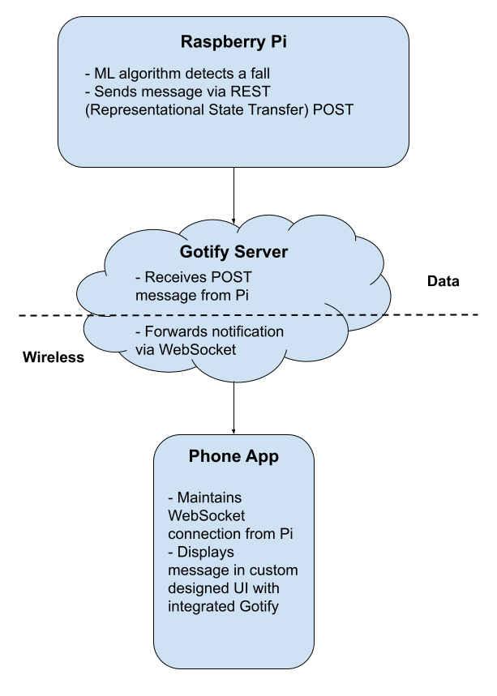
Data Subsystem
Gather Data
Label Data
Clean Data
- Scan a variety of falls (sitting, standing, laying down, etc.)
- Scan a variety of non-falls (standing still, sitting still, walking, sleeping, etc.)
- Labeling each of the falls and non-falls and how they occurred
- Removing the outliers, unnecessary data, missing, and irregular data
Report Results
Train Data
Feature Selection
- What constitutes a fall?
- Acceleration, Velocity,
Jerk, Duration of Movement, Height Change, Posture after Event
- Using a CNN, report results within a ±5% accuracy
- Create a training set, validation set, and testing set of our data

Slide 9
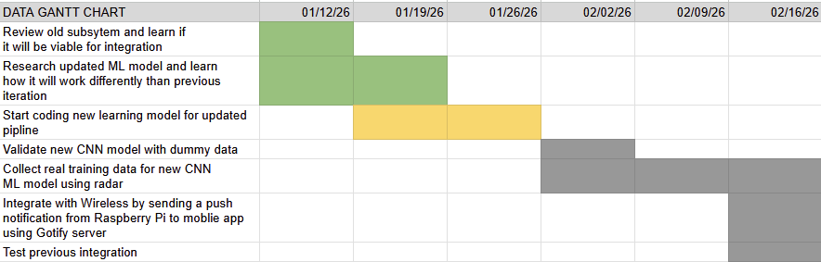
Data Gantt Chart
Data’s Two Week Plan

Slide 10
Wireless Subsystem
Owner
Accomplishments since 403 ~20 hrs of effort | Ongoing progress/problems and plans until the next presentation
The code for the radar’s data processing can track an object (person) and provide x, y, z, and velocity data for it at each time frame through UART The mobile app has a basic UI for the caregiver with simulated test alerts | Improve radar’s data processing code to provide more accurate data Debug what the script outputs to have a more seamless integration with the ML model

Slide 11
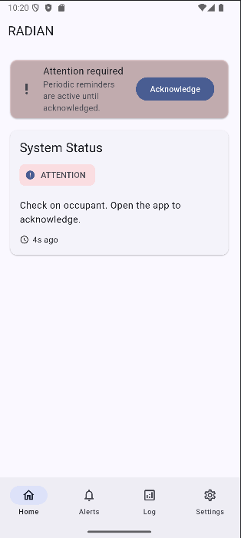
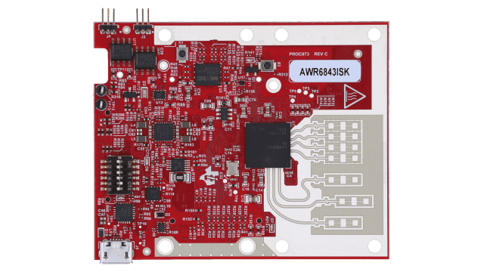
Wireless Subsystem
Radar is able to receive a configuration file and the code for the data processing produces positional data and velocity data with timestamps
The data processing needs to be more accurate and and output needs to be altered for easier integration with the ML model.
Mobile app can test simulated alerts, but the fall log needs debugging so it can log the alerts and accurately
Add more features for the caregiver

Slide 12
Wireless Gantt Chart
Wireless’s Two Week Plan
WIRELESS GANTT CHART | 01/12/26 | 01/19/26 | 01/26/26 | 02/02/26 | 02/06/26 | 02/16/26
Review the code for mobile app and radar to see where it was left off and decide what works still needs to be done and/or fixed.
Research ways to improve what is wanted/needed from radar
Debug and improve radar's data processing code
Begin to integrate with ML model and train with the radar's data
Test alerts going to the mobile app, debug/improve from there

Slide 13
Physical Subsystem
Accomplishments since 403 ~40 hrs of effort | Ongoing progress/problems and plans until the next presentation
Assembled Rev 2 Power Battery PCB. Fully tested the buck converter using a bench power supply. Verified the battery protection circuit is not tripped under no-load conditions. Confirmed the buck converter operates correctly at no load while simulating two series 18650 cells. | Continue MP2615 charger bring-up. Validate full range of 2S2P operation (8.4–6.0 V) with stable 5V. Confirm S-8252 UV/OC trip + recovery. Write a brief test report (measurements, pass/fail, photos, issues).

Slide 14
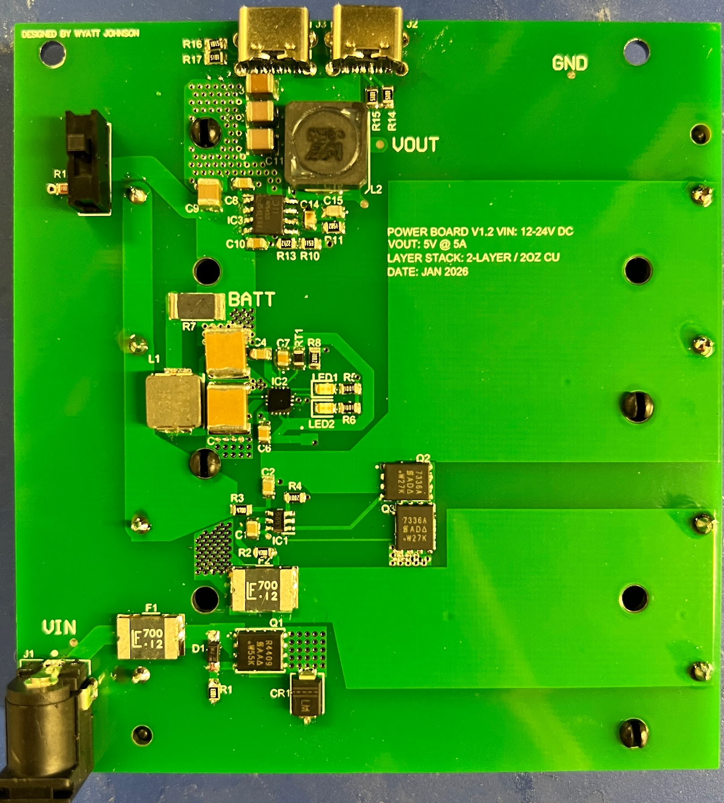
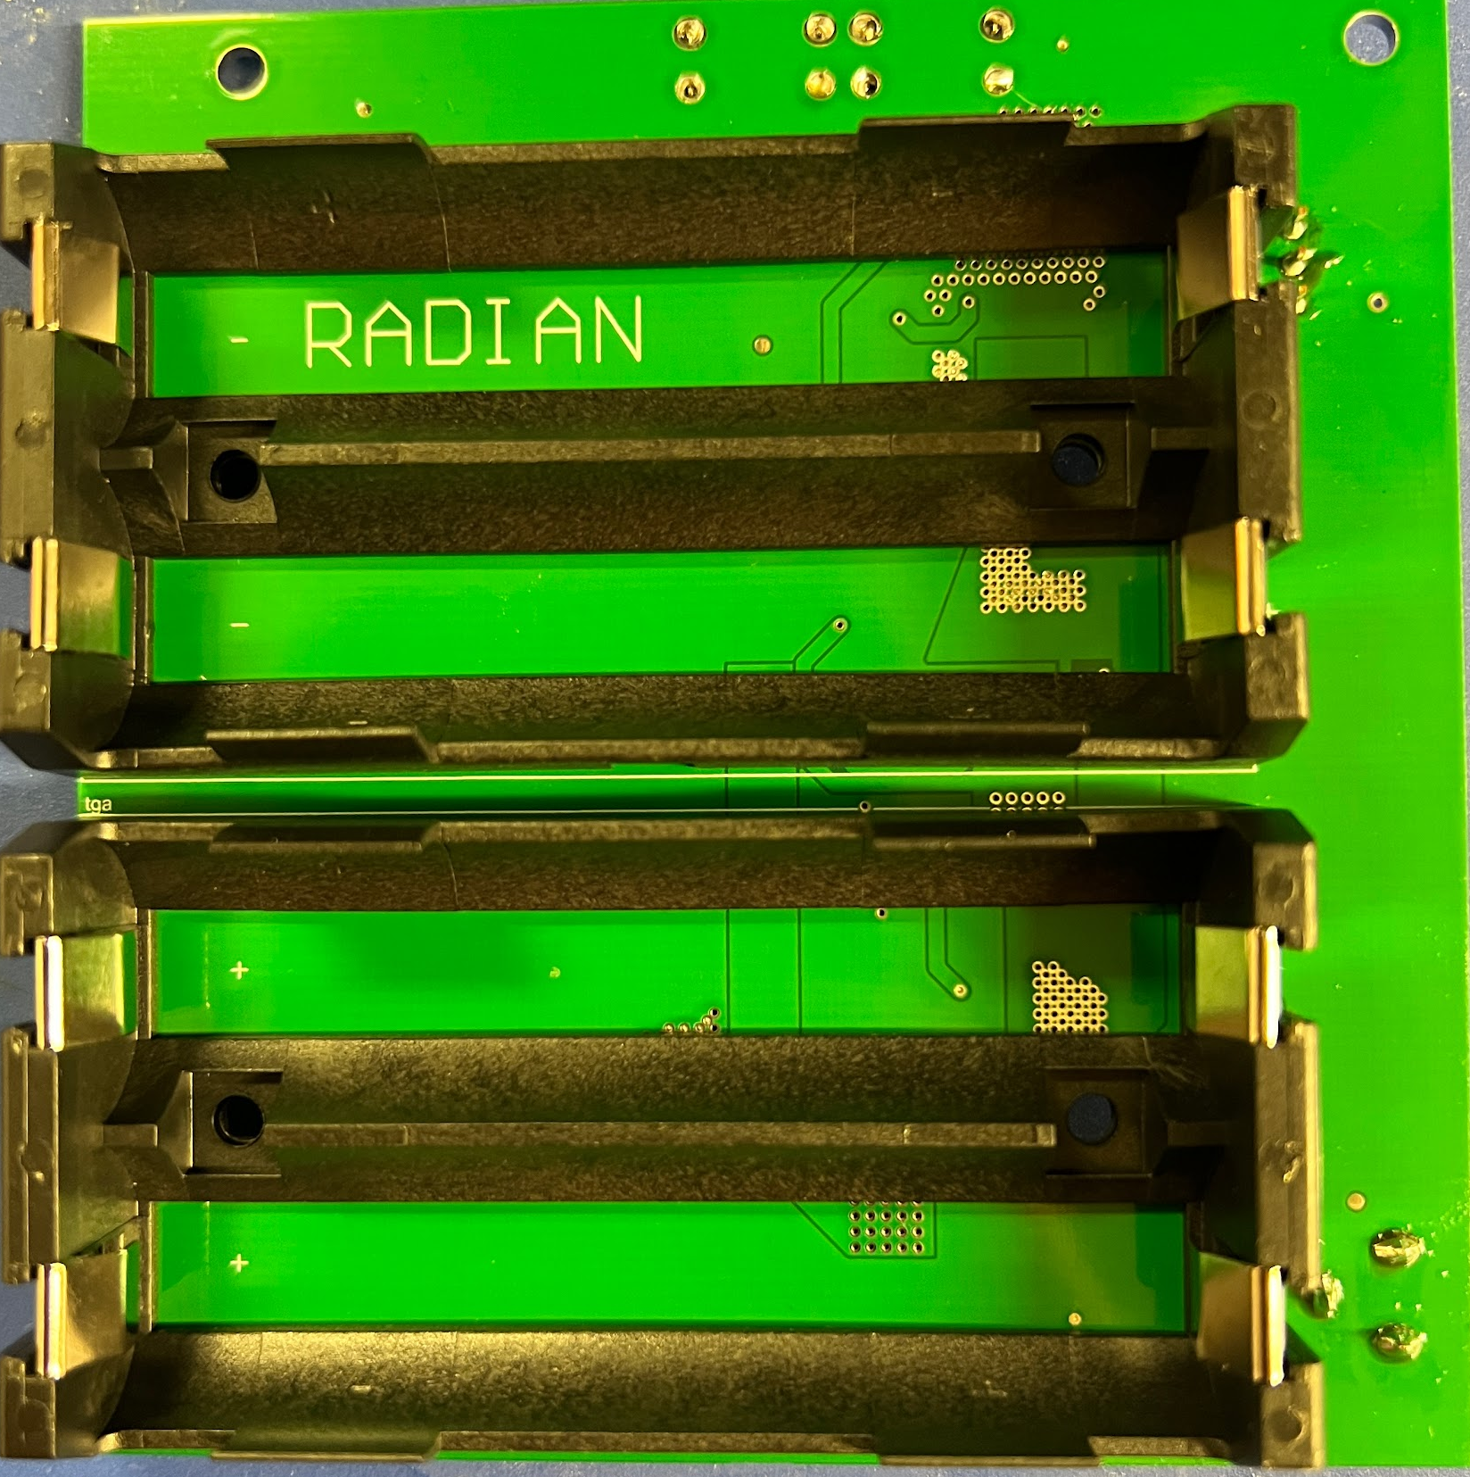
Physical Subsystem
Barrel Jack / 12V DC Input
MP2615 Charger IC
Battery Protection (S-8252)
5V Buck Converter (AP64501)
System 5V Rail (USB-C x2)
2S2P Li-Ion 18650 batteries

Slide 15
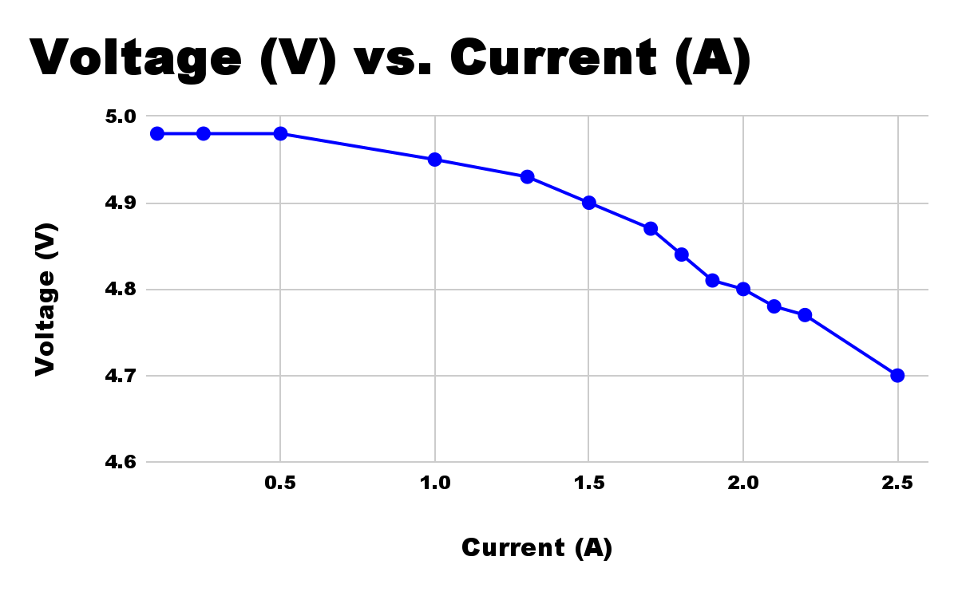
Buck Converter Load Test
(Vout vs Iout)
Current (A) | Voltage (V)
0.10 | 4.98
0.25 | 4.98
0.50 | 4.98
1.00 | 4.95
1.30 | 4.93
1.50 | 4.90
1.70 | 4.87
1.80 | 4.84
1.90 | 4.81
2.00 | 4.80
2.10 | 4.78
2.20 | 4.77
2.50 | 4.70
4.63

Slide 16
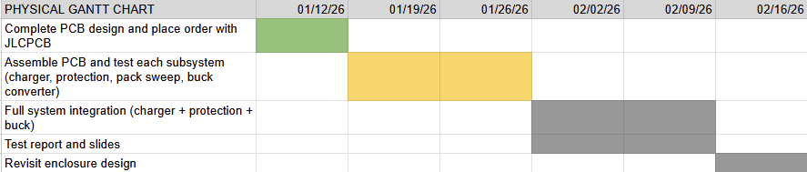
Physical Gantt Chart
Physical’s Two Week Plan

Slide 17
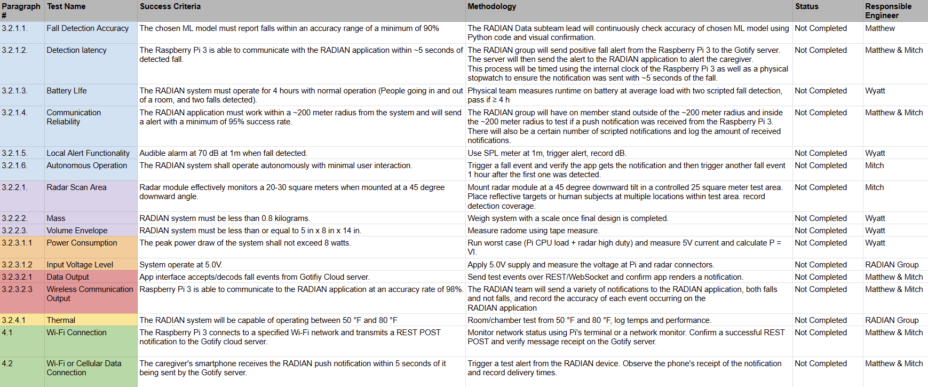
RADIAN Validation Plan
Notes:
Michelle

Slide 18
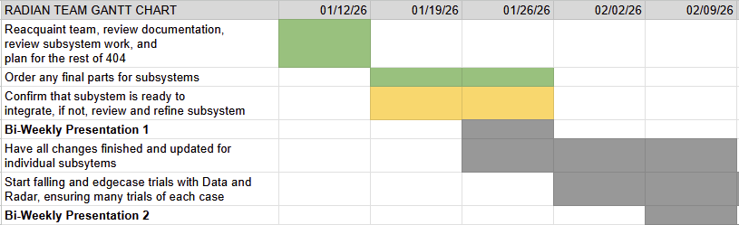
RADIAN Gantt Chart
RADIAN’s Two Week Plan
Notes:
Michelle

Slide 19
Thanks and Gig ‘Em
Any Questions?

